Slide 1
Netflix ppt

Slide 2
Contents
Jenis ada berapa yang film berapa yang serires v
Top 10 most listed diretors v
Mapping country where the most film/series made
Mapping country on year basis
Release year (line chart release date)
How many rating ada berapa -> what is the meaning
Duration based on series/film ->bar chart (warna)
Listed categories ada berapa

Slide 3
Out of 8807 contents Netflix published there ate
6131 movie
2676 tvshow

Slide 4
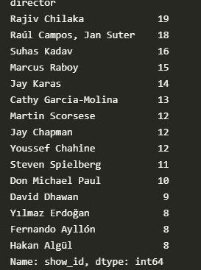
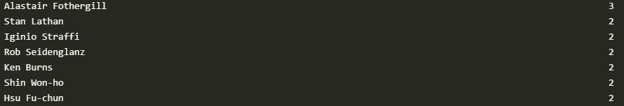
List of directors m
movie
TV show

Slide 5
Mapping country

